Slide 1


LET US C
BY YASHAVANT KANETKAR
CH 2 [H]
CH 2 [F]
CH 2 [D]
CH 2 [B]
CH 2 [G]
CH 2 [E]
CH 2 [C]
CH 2 [A]
CHAPTER 2 SOLUTIONS
C INSTRUCTIONS

Slide 2
CHAPTER 2 SOLUTIONS
C INSTRUCTIONS
Q[A] Point out the errors, if any, in the following C statements:
x=(y+3);
cir=2*3.141593*r;
char=‘3’;
4/3*3.14*r*r*r=vol_of_sphere;
volume=a³;
…(l), (m)
CH 2 [F]
CH 2 [B]
CH 2 [E]
CH 2 [D]
CH 2 [H]
CH 2 [C]
CH 2 [G]
CH 2 [A]
BOOK: LET US C
BY YASHAVANT KANETHKAR

Slide 3
CHAPTER 2 SOLUTIONS
C INSTRUCTIONS
(a) x=(y+3);
Ans: No error.
CH 2 [H]
CH 2 [F]
CH 2 [B]
CH 2 [E]
CH 2 [D]
CH 2 [G]
CH 2 [C]
CH 2 [A]
(b) cir=2*3.141593*r;
Ans: No error.
BOOK: LET US C
BY YASHAVANT KANETHKAR

Slide 4
CHAPTER 2 SOLUTIONS
C INSTRUCTIONS
(c) char=‘3’;
Ans: Error! "char" is a keyword and a keyword cannot be used as a variable name.
CH 2 [F]
CH 2 [B]
CH 2 [E]
CH 2 [D]
CH 2 [H]
CH 2 [C]
CH 2 [G]
CH 2 [A]
BOOK: LET US C
BY YASHAVANT KANETHKAR

Slide 5
CHAPTER 2 SOLUTIONS
C INSTRUCTIONS
(d) 4/3*3.14*r*r*r=vol_of_sphere;
Ans: Error: lvalue required as left operand of assignment
C allows only one variable on left hand side of “=“ assignment operator.
CH 2 [F]
CH 2 [B]
CH 2 [E]
CH 2 [D]
CH 2 [H]
CH 2 [C]
CH 2 [G]
CH 2 [A]
BOOK: LET US C
BY YASHAVANT KANETHKAR

Slide 6
CHAPTER 2 SOLUTIONS
C INSTRUCTIONS
(e) volume=a³;
Ans: Error! There is no operator in C to perform exponentiation operation. You can write this statement as volume=a*a*a;
CH 2 [F]
CH 2 [B]
CH 2 [E]
CH 2 [D]
CH 2 [H]
CH 2 [C]
CH 2 [G]
CH 2 [A]
BOOK: LET US C
BY YASHAVANT KANETHKAR
Notes:
a3 doesn't specify any operation.

Slide 7
CHAPTER 2 SOLUTIONS
C INSTRUCTIONS
(f) area=1/2*base*height;
Ans: No error.
CH 2 [H]
CH 2 [F]
CH 2 [B]
CH 2 [E]
CH 2 [D]
CH 2 [G]
CH 2 [C]
CH 2 [A]
(g) si=p*n*r/100;
Ans: No error.
BOOK: LET US C
BY YASHAVANT KANETHKAR

Slide 8
CHAPTER 2 SOLUTIONS
C INSTRUCTIONS
(h) area of circle=3.14*r*r;
Ans: Error! spaces are not allowed in variable names.
CH 2 [F]
CH 2 [B]
CH 2 [E]
CH 2 [D]
CH 2 [H]
CH 2 [C]
CH 2 [G]
CH 2 [A]
(i) peri_of_tri=a+b+c;
Ans: No error.
BOOK: LET US C
BY YASHAVANT KANETHKAR
Notes:
a3 doesn't specify any operation.

Slide 9
CHAPTER 2 SOLUTIONS
C INSTRUCTIONS
(j) slope=(y2-y1)÷(x2-x1);
Ans: Error! “÷" is not any valid operator. / is the division operator in C.
CH 2 [F]
CH 2 [B]
CH 2 [E]
CH 2 [D]
CH 2 [H]
CH 2 [C]
CH 2 [G]
CH 2 [A]
BOOK: LET US C
BY YASHAVANT KANETHKAR
Notes:
a3 doesn't specify any operation.

Slide 10
CHAPTER 2 SOLUTIONS
C INSTRUCTIONS
(k) 3=b=4=a;
Ans: Error: lvalue required as left operand of assignment
A variable name must be present on the left hand side of “=” operator.
CH 2 [F]
CH 2 [B]
CH 2 [E]
CH 2 [D]
CH 2 [H]
CH 2 [C]
CH 2 [G]
CH 2 [A]
BOOK: LET US C
BY YASHAVANT KANETHKAR
Notes:
a3 doesn't specify any operation.

Slide 11
CHAPTER 2 SOLUTIONS
C INSTRUCTIONS
(l) count = count + 1;
Ans: No error.
CH 2 [F]
CH 2 [B]
CH 2 [E]
CH 2 [D]
CH 2 [H]
CH 2 [C]
CH 2 [G]
(m) char ch=’25 Apr 12’;
Ans: Error! A character constant cannot have multiple characters.
CH 2 [A]
BOOK: LET US C
BY YASHAVANT KANETHKAR
Notes:
a3 doesn't specify any operation.

Slide 12
CHAPTER 2 SOLUTIONS
C INSTRUCTIONS
Q[B] Evaluate the following expressions and show their hierarchy.
ans = 5*b*b*x-3*a*y*y-8*b*b*x+10*a*y;
(a=3, b=2, x=5, y=4 assume ans
to be an int)
…(b), (c), (d)
CH 2 [F]
CH 2 [B]
CH 2 [G]
CH 2 [E]
CH 2 [D]
CH 2 [H]
CH 2 [C]
CH 2 [A]
BOOK: LET US C
BY YASHAVANT KANETHKAR

Slide 13
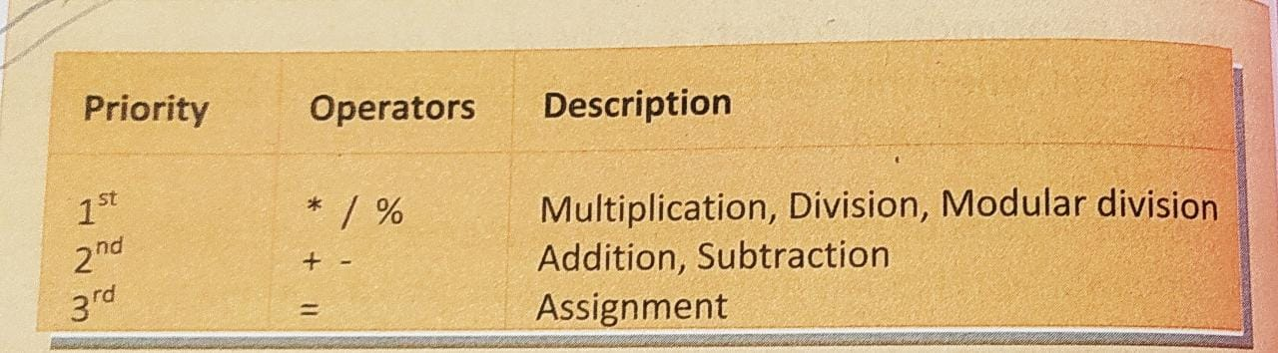
CHAPTER 2 SOLUTIONS
C INSTRUCTIONS
✍️ The priority or precedence in which the operations in an arithmetic statement are performed is called the hierarchy of operations. The hierarchy of commonly used operators is shown below:
CH 2 [F]
CH 2 [B]
CH 2 [G]
CH 2 [E]
CH 2 [D]
CH 2 [H]
CH 2 [C]
CH 2 [A]
BOOK: LET US C
BY YASHAVANT KANETHKAR

Slide 14
CHAPTER 2 SOLUTIONS
C INSTRUCTIONS
✍️ Operators having equal precedence are evaluated using associativity of operators.
✍️ Associativity of all operators is either left to right or right to left.
👉 +, - has same priority and left to right associativity. 👉
👉 *, /, % has same priority and left to right associativity. 👉
👈 = has right to left associativity. 👈
CH 2 [F]
CH 2 [B]
CH 2 [G]
CH 2 [E]
CH 2 [D]
CH 2 [H]
CH 2 [C]
CH 2 [A]
BOOK: LET US C
BY YASHAVANT KANETHKAR

Slide 15
CHAPTER 2 SOLUTIONS
C INSTRUCTIONS
(a) ans = 5*b*b*x-3*a*y*y-8*b*b*x+10*a*y;
(a=3, b=2, x=5, y=4 assume ans to be an int)
Ans:
ans=5*2*2*5-3*3*4*4-8*2*2*5+10*3*4;
ans=10*2*5-3*3*4*4-8*2*2*5+10*3*4;
ans=20*5-3*3*4*4-8*2*2*5+10*3*4;
ans=100-3*3*4*4-8*2*2*5+10*3*4;
ans=100-9*4*4-8*2*2*5+10*3*4;
ans=100-36*4-8*2*2*5+10*3*4;
ans=100-144-8*2*2*5+10*3*4;
CH 2 [F]
CH 2 [B]
CH 2 [G]
CH 2 [E]
CH 2 [D]
CH 2 [H]
CH 2 [C]
CH 2 [A]
BOOK: LET US C
BY YASHAVANT KANETHKAR

Slide 16
CHAPTER 2 SOLUTIONS
C INSTRUCTIONS
ans=100-144-8*2*2*5+10*3*4;
ans=100-144-16*2*5+10*3*4;
ans=100-144-32*5+10*3*4;
ans=100-144-160+10*3*4;
ans=100-144-160+30*4;
ans=100-144-160+120;
ans=-44-160+120;
ans=-204+120;
ans=-84;
CH 2 [F]
CH 2 [B]
CH 2 [G]
CH 2 [E]
CH 2 [D]
CH 2 [H]
CH 2 [C]
CH 2 [A]
BOOK: LET US C
BY YASHAVANT KANETHKAR

Slide 17
CHAPTER 2 SOLUTIONS
C INSTRUCTIONS
(a) ans = 5*b*b*x-3*a*y*y-8*b*b*x+10*a*y;
(a=3, b=2, x=5, y=4 assume ans to be an int)
Ans: ans=5*2*2*5-3*3*4*4-8*2*2*5+10*3*4;
ans=10*2*5-3*3*4*4-8*2*2*5+10*3*4; Operation: *
ans=20*5-3*3*4*4-8*2*2*5+10*3*4; Operation: *
ans=100-3*3*4*4-8*2*2*5+10*3*4; Operation: *
ans=100-9*4*4-8*2*2*5+10*3*4; Operation: *
ans=100-36*4-8*2*2*5+10*3*4; Operation: *
ans=100-144-8*2*2*5+10*3*4; Operation: *
ans=100-144-8*2*2*5+10*3*4; Operation: *
ans=100-144-16*2*5+10*3*4; Operation: *
ans=100-144-32*5+10*3*4; Operation: *
ans=100-144-160+10*3*4; Operation: *
ans=100-144-160+30*4; Operation: *
ans=100-144-160+120; Operation: *
ans=-44-160+120; Operation: -
ans=-204+120; Operation: -
ans=-84; Operation: +
CH 2 [F]
CH 2 [B]
CH 2 [G]
CH 2 [E]
CH 2 [D]
CH 2 [H]
CH 2 [C]
CH 2 [A]
BOOK: LET US C
BY YASHAVANT KANETHKAR

Slide 18
CHAPTER 2 SOLUTIONS
C INSTRUCTIONS
(b) res = 4*a*y/c-a*y/c;
(a=4, y=1, c=3, assume res to be an int)
Ans:
res=4*4*1/3-4*1/3;
res=16*1/3-4*1/3; Operation: *
res=16/3-4*1/3; Operation: *
res=5-4*1/3; Operation: /
res=5-4/3; Operation: *
res=5-1; Operation: /
res=4; Operation: -
CH 2 [F]
CH 2 [B]
CH 2 [G]
CH 2 [E]
CH 2 [D]
CH 2 [H]
CH 2 [C]
CH 2 [A]
BOOK: LET US C
BY YASHAVANT KANETHKAR

Slide 19
CHAPTER 2 SOLUTIONS
C INSTRUCTIONS
(c) s = c+a*y*y/b;
(a=2.2, b=0.0, c=4.1, y=3.0, assume s to be a float)
Ans:
s=4.1+2.2*3.0*3.0/0.0;
s=4.1+6.6*3.0/0.0; Operation: *
s=4.1+19.8/0.0; Operation: *
s=4.1+1.#INF00; Operation: /
s=1.#INF00; Operation: +
CH 2 [F]
CH 2 [B]
CH 2 [G]
CH 2 [E]
CH 2 [D]
CH 2 [H]
CH 2 [C]
CH 2 [A]
BOOK: LET US C
BY YASHAVANT KANETHKAR

Slide 20
CHAPTER 2 SOLUTIONS
C INSTRUCTIONS
(d) R = x*x+2*x+1/2*x*x+x+1;
(a=3.5, assume R to be a float)
Ans:
R=3.5*3.5+2*3.5+1/2*3.5*3.5+3.5+1;
R=12.25+2*3.5+1/2*3.5*3.5+3.5+1; Operation: *
R=12.25+7.0+1/2*3.5*3.5+3.5+1; Operation: *
R=12.25+7.0+0*3.5*3.5+3.5+1; Operation: /
R=12.25+7.0+0*3.5+3.5+1; Operation: *
R=12.25+7.0+0+3.5+1; Operation: *
R=19.25+0+3.5+1; Operation: +
R=19.25+3.5+1; Operation: +
R=22.75+1; Operation: +
R=23.75; Operation: +
CH 2 [F]
CH 2 [B]
CH 2 [G]
CH 2 [E]
CH 2 [D]
CH 2 [H]
CH 2 [C]
CH 2 [A]
BOOK: LET US C
BY YASHAVANT KANETHKAR

Slide 21
CHAPTER 2 SOLUTIONS
C INSTRUCTIONS
Q[C] Indicate the order in which the following expressions would be evaluated:
g=10/5/2/1;
b=3/2+5*4/3;
a=b=c=3+4;
x=2-3+5*2/8%3;
z=5%3/8*3+4;
y=z=-3%-8/2+7;
CH 2 [H]
CH 2 [F]
CH 2 [B]
CH 2 [G]
CH 2 [E]
CH 2 [D]
CH 2 [C]
CH 2 [A]
BOOK: LET US C
BY YASHAVANT KANETHKAR

Slide 22
CHAPTER 2 SOLUTIONS
C INSTRUCTIONS
Q[C] Indicate the order in which the following expressions would be evaluated:
g=10/5/2/1; 🔰/5 /2 /1 =
b=3/2+5*4/3; 🔰/2 * /3 + =
a=b=c=3+4; 🔰+ c= b= a=
x=2-3+5*2/8%3; 🔰* / % - + =
z=5%3/8*3+4; 🔰% / * + =
y=z=-3%-8/2+7; 🔰% / + =
CH 2 [H]
CH 2 [F]
CH 2 [B]
CH 2 [G]
CH 2 [E]
CH 2 [D]
CH 2 [C]
CH 2 [A]
BOOK: LET US C
BY YASHAVANT KANETHKAR

Slide 23

CHAPTER 2 SOLUTIONS
C INSTRUCTIONS
Q[D] Convert the following algebraic expressions into equivalent C statements:
(a) $Z=\frac{\left(x+3\right)x^{3}}{\left(y−4\right)\left(y+5\right)}$
(b) $R=\frac{2v+6.22\left(c+d\right)}{g+v}$
(c) $A=\frac{{7.7b\left(xy+a\right)}/{c−0.8+2b}}{(x+a)(1/y)}$ …(d)
CH 2 [H]
CH 2 [F]
CH 2 [B]
CH 2 [G]
CH 2 [E]
CH 2 [D]
CH 2 [C]
CH 2 [A]
BOOK: LET US C
BY YASHAVANT KANETHKAR

Slide 24
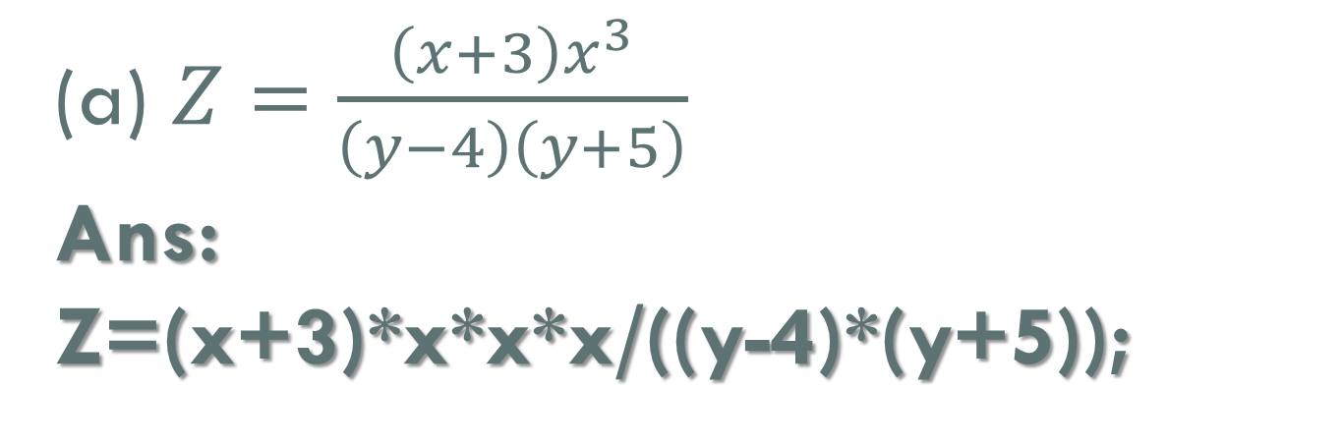
CHAPTER 2 SOLUTIONS
C INSTRUCTIONS
(a) $Z=\frac{\left(x+3\right)x^{3}}{\left(y−4\right)\left(y+5\right)}$
Ans:
Z=(x+3)*x*x*x/((y-4)*(y+5));
CH 2 [H]
CH 2 [F]
CH 2 [B]
CH 2 [G]
CH 2 [E]
CH 2 [D]
CH 2 [C]
CH 2 [A]
BOOK: LET US C
BY YASHAVANT KANETHKAR

Slide 25
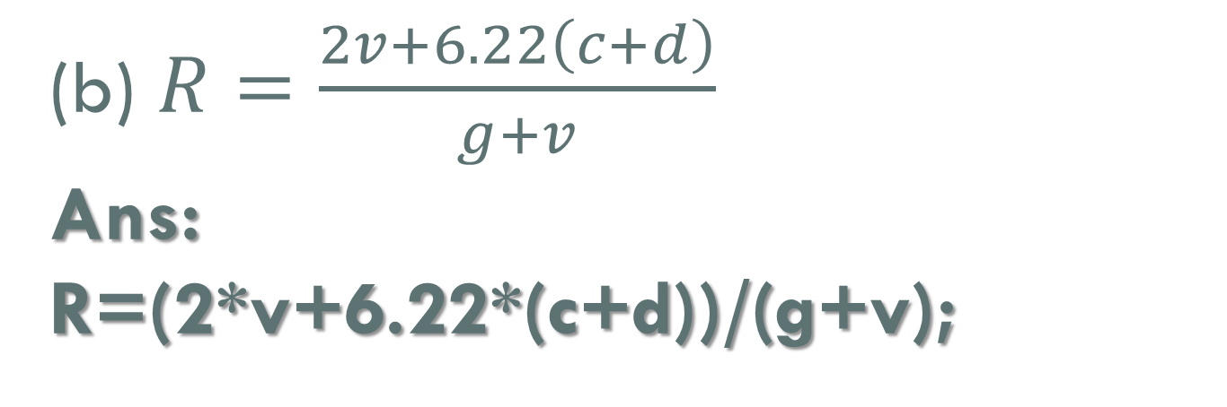

CHAPTER 2 SOLUTIONS
C INSTRUCTIONS
(a) $Z=\frac{\left(x+3\right)x^{3}}{\left(y−4\right)\left(y+5\right)}$
Ans:
Z=(x+3)*x*x*x/((y-4)*(y+5));
CH 2 [H]
CH 2 [F]
CH 2 [B]
CH 2 [G]
CH 2 [E]
CH 2 [D]
CH 2 [C]
CH 2 [A]
(b) $R=\frac{2v+6.22\left(c+d\right)}{g+v}$
Ans:
R=(2*v+6.22*(c+d))/(g+v);
BOOK: LET US C
BY YASHAVANT KANETHKAR

Slide 26
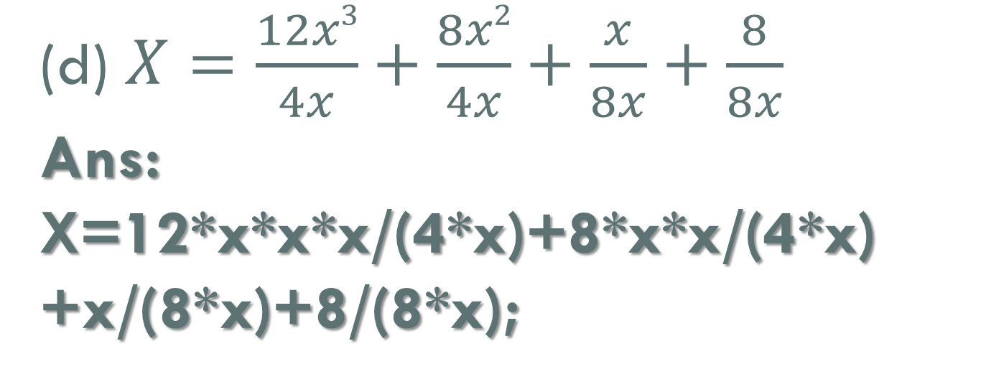
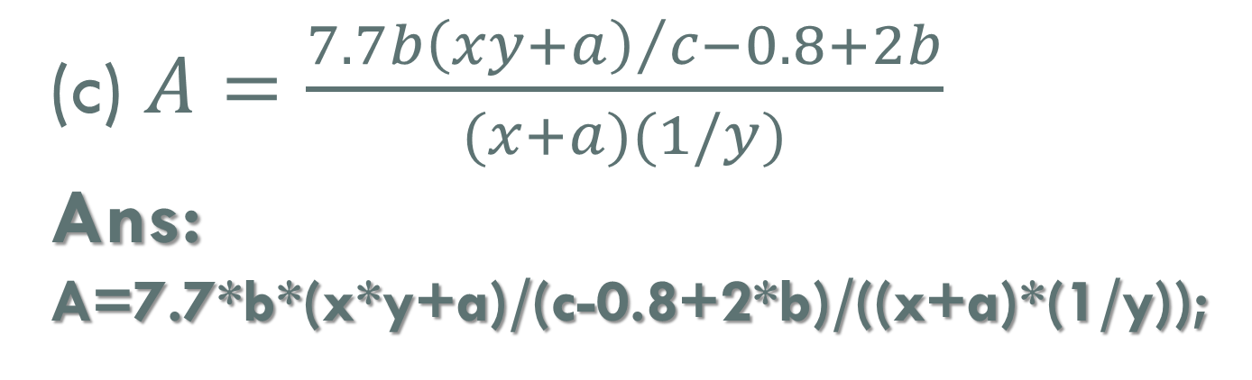
CHAPTER 2 SOLUTIONS
C INSTRUCTIONS
(c) $A=\frac{{7.7b\left(xy+a\right)}/{c−0.8+2b}}{(x+a)(1/y)}$
Ans:
A=7.7*b*(x*y+a)/(c-0.8+2*b)/((x+a)*(1/y));
CH 2 [H]
CH 2 [F]
(d) $X=\frac{12x3}{4x}+\frac{8x2}{4x}+\frac{x}{8x}+\frac{8}{8x}$
Ans:
X=12*x*x*x/(4*x)+8*x*x/(4*x)
+x/(8*x)+8/(8*x);
CH 2 [B]
CH 2 [G]
CH 2 [E]
CH 2 [D]
CH 2 [C]
CH 2 [A]
BOOK: LET US C
BY YASHAVANT KANETHKAR

Slide 27
CHAPTER 2 SOLUTIONS
C INSTRUCTIONS
Q[E] What will be the output of the following programs:
CH 2 [H]
CH 2 [F]
CH 2 [B]
CH 2 [G]
CH 2 [E]
CH 2 [D]
CH 2 [C]
CH 2 [A]
BOOK: LET US C
BY YASHAVANT KANETHKAR

Slide 28
CHAPTER 2 SOLUTIONS
C INSTRUCTIONS
#include <stdio.h>
int main()
{
int i = 2, j = 3, k, l;
float a, b;
k = i / j * j;
l = j / i * i ;
a = i / j * j;
b = j / i * i;
printf("%d %d %f %f\n", k, l, a, b);
return 0;
}
(a)
(a)
CH 2 [H]
CH 2 [F]
CH 2 [B]
CH 2 [G]
CH 2 [E]
CH 2 [D]
CH 2 [C]
CH 2 [A]
Output: 0 2 0.000000 2.000000
BOOK: LET US C
BY YASHAVANT KANETHKAR

Slide 29
CHAPTER 2 SOLUTIONS
C INSTRUCTIONS
(b)
#include <stdio.h>
int main()
{
int a, b, c, d;
a = 2%5;
b = -2%5;
c = 2%-5;
d = -2%-5;
printf("a = %d b = %d c = %d d = %d\n", a, b, c, d);
return 0;
}
✍️ On using % the sign of the remainder is always the same as the sign of the numerator.
(a)
CH 2 [H]
CH 2 [F]
CH 2 [B]
CH 2 [G]
CH 2 [E]
CH 2 [D]
CH 2 [C]
CH 2 [A]
Output:
a = 2 b = -2 c = 2 d = -2
BOOK: LET US C
BY YASHAVANT KANETHKAR

Slide 30

CHAPTER 2 SOLUTIONS
C INSTRUCTIONS
#include <stdio.h>
int main()
{
float a = 5, b = 2;
int c, d ;
c = a % b;
d = a / 2;
printf("%d\n", d);
return 0;
}
(c)
(a)
CH 2 [H]
CH 2 [F]
CH 2 [B]
CH 2 [G]
CH 2 [E]
CH 2 [D]
CH 2 [C]
CH 2 [A]
✍️ Modulus Operator (%) cannot be applied on a float.
BOOK: LET US C
BY YASHAVANT KANETHKAR

Slide 31
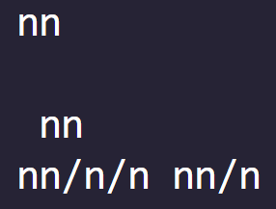
CHAPTER 2 SOLUTIONS
C INSTRUCTIONS
#include <stdio.h>
int main()
{
printf("nn \n\n nn\n");
printf("nn/n/n nn/n" );
return 0;
}
(d)
(a)
CH 2 [H]
CH 2 [F]
CH 2 [B]
CH 2 [G]
CH 2 [E]
CH 2 [D]
CH 2 [C]
CH 2 [A]
Output:
BOOK: LET US C
BY YASHAVANT KANETHKAR

Slide 32
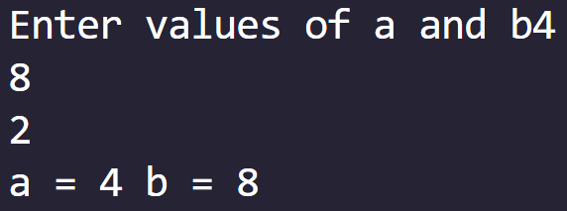
CHAPTER 2 SOLUTIONS
C INSTRUCTIONS
#include <stdio.h>
int main()
{
int a, b;
printf("Enter values of a and b");
scanf(" %d %d ", &a, &b);
printf("a = %d b = %d", a, b);
return 0;
}
(e)
(a)
CH 2 [H]
CH 2 [F]
CH 2 [B]
CH 2 [G]
CH 2 [E]
CH 2 [D]
CH 2 [C]
CH 2 [A]
Output:
BOOK: LET US C
BY YASHAVANT KANETHKAR

Slide 33
CHAPTER 2 SOLUTIONS
C INSTRUCTIONS
Q[F] State whether the following statements are True or False:
* or /, + or – represents the correct hierarchy of arithmetic operators in C.
[ ] and { } can be used in Arithmetic instructions.
…(e), (f)
CH 2 [H]
CH 2 [B]
CH 2 [G]
CH 2 [F]
CH 2 [E]
CH 2 [D]
CH 2 [C]
CH 2 [A]
BOOK: LET US C
BY YASHAVANT KANETHKAR

Slide 34
CHAPTER 2 SOLUTIONS
C INSTRUCTIONS
(a) * or /, + or – represents the correct hierarchy of arithmetic operators in C.
Ans: True
CH 2 [H]
CH 2 [B]
CH 2 [G]
CH 2 [F]
CH 2 [E]
CH 2 [D]
CH 2 [C]
CH 2 [A]
BOOK: LET US C
BY YASHAVANT KANETHKAR

Slide 35
CHAPTER 2 SOLUTIONS
C INSTRUCTIONS
(b) [ ] and { } can be used in Arithmetic instructions.
Ans: False
CH 2 [H]
CH 2 [B]
CH 2 [G]
CH 2 [F]
CH 2 [E]
CH 2 [D]
CH 2 [C]
CH 2 [A]
BOOK: LET US C
BY YASHAVANT KANETHKAR

Slide 36
CHAPTER 2 SOLUTIONS
C INSTRUCTIONS
(c) Hierarchy decides which operator is used first.
Ans: True
CH 2 [H]
CH 2 [B]
CH 2 [G]
CH 2 [F]
CH 2 [E]
CH 2 [D]
CH 2 [C]
CH 2 [A]
BOOK: LET US C
BY YASHAVANT KANETHKAR

Slide 37
CHAPTER 2 SOLUTIONS
C INSTRUCTIONS
(d) In C** operator is used for exponentiation operation.
Ans: False
CH 2 [H]
CH 2 [B]
CH 2 [G]
CH 2 [F]
CH 2 [E]
CH 2 [D]
CH 2 [C]
CH 2 [A]
BOOK: LET US C
BY YASHAVANT KANETHKAR

Slide 38
CHAPTER 2 SOLUTIONS
C INSTRUCTIONS
(e) In C, Arithmetic instruction cannot contain constants on left side of =.
Ans: True
CH 2 [H]
CH 2 [B]
CH 2 [G]
CH 2 [F]
CH 2 [E]
CH 2 [D]
CH 2 [C]
CH 2 [A]
BOOK: LET US C
BY YASHAVANT KANETHKAR

Slide 39
CHAPTER 2 SOLUTIONS
C INSTRUCTIONS
(f) % operator cannot be used with floats.
Ans: True
CH 2 [H]
CH 2 [B]
CH 2 [G]
CH 2 [F]
CH 2 [E]
CH 2 [D]
CH 2 [C]
CH 2 [A]
BOOK: LET US C
BY YASHAVANT KANETHKAR

Slide 40
CHAPTER 2 SOLUTIONS
C INSTRUCTIONS
Q[G] Fill in the blanks:
In y=10*x/2+z; ____ operation will be performed first.
If a is an integer variable, a=11/2; will store _____ in a.
The expression, a=22/7*5/3; would evaluate to _____.
…(d), (e)
CH 2 [H]
CH 2 [G]
CH 2 [E]
CH 2 [B]
CH 2 [F]
CH 2 [C]
CH 2 [D]
CH 2 [A]
BOOK: LET US C
BY YASHAVANT KANETHKAR

Slide 41
CHAPTER 2 SOLUTIONS
C INSTRUCTIONS
(a) In y=10*x/2+z; ____ operation will be performed first.
Ans: *
CH 2 [H]
CH 2 [G]
CH 2 [E]
CH 2 [B]
CH 2 [F]
CH 2 [C]
CH 2 [D]
CH 2 [A]
BOOK: LET US C
BY YASHAVANT KANETHKAR

Slide 42
CHAPTER 2 SOLUTIONS
C INSTRUCTIONS
(b) If a is an integer variable, a=11/2; will store _____ in a.
Ans: 5
CH 2 [H]
CH 2 [G]
CH 2 [E]
CH 2 [B]
CH 2 [F]
CH 2 [C]
CH 2 [D]
CH 2 [A]
BOOK: LET US C
BY YASHAVANT KANETHKAR

Slide 43
CHAPTER 2 SOLUTIONS
C INSTRUCTIONS
(c) The expression, a=22/7*5/3; would evaluate to _____.
Ans: 5
a=22/7*5/3;
a=3*5/3;
a=15/3;
a=5;
CH 2 [H]
CH 2 [G]
CH 2 [E]
CH 2 [B]
CH 2 [F]
CH 2 [C]
CH 2 [D]
CH 2 [A]
BOOK: LET US C
BY YASHAVANT KANETHKAR

Slide 44
CHAPTER 2 SOLUTIONS
C INSTRUCTIONS
(d) The expression x=-7% 2 – 8 would evaluate to _____.
Ans: -9
x=-7% 2 – 8
x=-1– 8
x=-9
CH 2 [H]
CH 2 [G]
CH 2 [E]
CH 2 [B]
CH 2 [F]
CH 2 [C]
CH 2 [D]
CH 2 [A]
BOOK: LET US C
BY YASHAVANT KANETHKAR

Slide 45
CHAPTER 2 SOLUTIONS
C INSTRUCTIONS
(e) If d is a float the operation d = 2 / 7.0 would store _____ in d.
Ans: 0.285714
CH 2 [H]
CH 2 [G]
CH 2 [E]
CH 2 [B]
CH 2 [F]
CH 2 [C]
CH 2 [D]
CH 2 [A]
BOOK: LET US C
BY YASHAVANT KANETHKAR

Slide 46
CHAPTER 2 SOLUTIONS
C INSTRUCTIONS
Q[H] Attempt the following:
(a) If a five-digit number is input through the keyboard, write a program to calculate the sum of its digits. (Hint: use the modulus operator ‘%’).
CH 2 [H]
CH 2 [B]
CH 2 [G]
CH 2 [F]
CH 2 [E]
CH 2 [D]
CH 2 [C]
CH 2 [A]
BOOK: LET US C
BY YASHAVANT KANETHKAR

Slide 47
CHAPTER 2 SOLUTIONS
C INSTRUCTIONS
Q[H] Attempt the following:
(b) If a five-digit number is input through the keyboard, write a program to reverse the number.
CH 2 [H]
CH 2 [B]
CH 2 [G]
CH 2 [F]
CH 2 [E]
CH 2 [D]
CH 2 [C]
CH 2 [A]
BOOK: LET US C
BY YASHAVANT KANETHKAR

Slide 48
CHAPTER 2 SOLUTIONS
C INSTRUCTIONS
Q[H] Attempt the following:
(c) If lengths of three sides of a triangle are input through the keyboard, write a program to find the area of the triangle.
CH 2 [H]
CH 2 [B]
CH 2 [G]
CH 2 [F]
CH 2 [E]
CH 2 [D]
CH 2 [C]
CH 2 [A]
BOOK: LET US C
BY YASHAVANT KANETHKAR

Slide 49
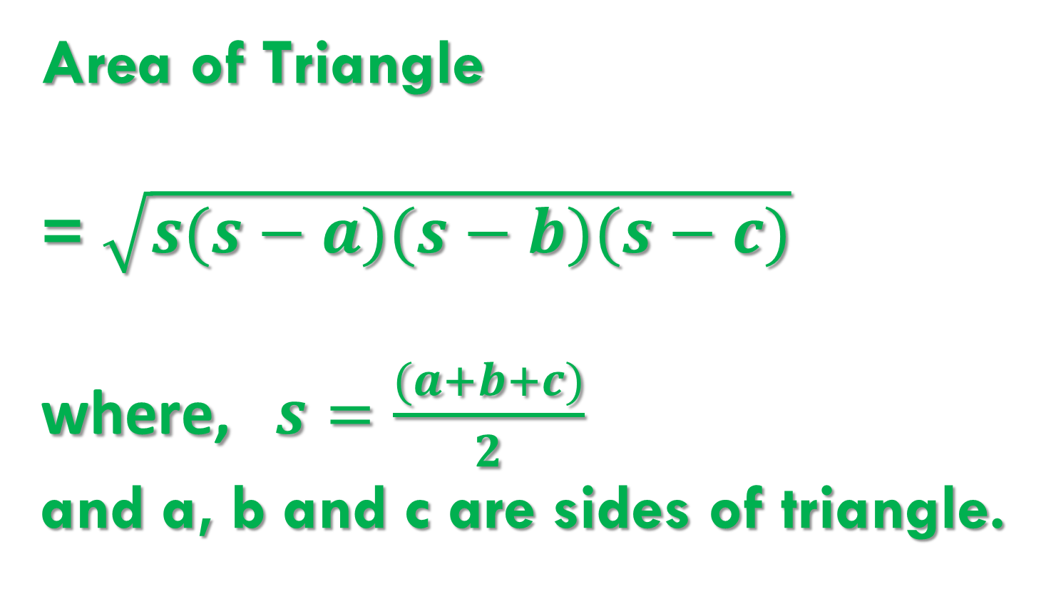
CHAPTER 2 SOLUTIONS
C INSTRUCTIONS
Area of Triangle
= $\sqrt{s(s−a)(s−b)(s−c)}$
where, $s=\frac{(a+b+c)}{2}$
and a, b and c are sides of triangle.
CH 2 [H]
CH 2 [B]
CH 2 [G]
CH 2 [F]
CH 2 [E]
CH 2 [D]
CH 2 [C]
CH 2 [A]
BOOK: LET US C
BY YASHAVANT KANETHKAR

Slide 50
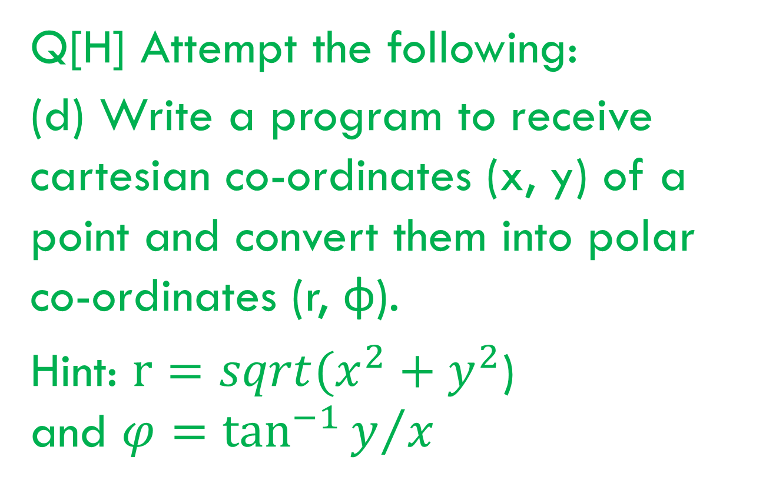
CHAPTER 2 SOLUTIONS
C INSTRUCTIONS
Q[H] Attempt the following:
(d) Write a program to receive cartesian co-ordinates (x, y) of a point and convert them into polar co-ordinates (r, φ).
Hint: $r=sqrt(x^{2}+y^{2}$)
and $φ=\tan^{−1}{y/x}$
CH 2 [H]
CH 2 [B]
CH 2 [G]
CH 2 [F]
CH 2 [E]
CH 2 [D]
CH 2 [C]
CH 2 [A]
BOOK: LET US C
BY YASHAVANT KANETHKAR

Slide 51
CHAPTER 2 SOLUTIONS
C INSTRUCTIONS
✍️ atan function only returns a result in the range of -π/2 to π/2, which means it can only determine the angle of a point in the 1st or 4th quadrants.
✍️ While atan2 function returns a result in the full range of -π to π, which means it can determine the angle of a point in any quadrant.
CH 2 [H]
CH 2 [B]
CH 2 [G]
CH 2 [F]
CH 2 [E]
CH 2 [D]
CH 2 [C]
CH 2 [A]
BOOK: LET US C
BY YASHAVANT KANETHKAR

Slide 52
CHAPTER 2 SOLUTIONS
C INSTRUCTIONS
The atan2 function is a variant of the atan (arctangent) function that is often used to compute the angle of a point in polar coordinates from its Cartesian coordinates. The reason atan2 is used instead of atan is because it is better at handling the "quadrant" of the point, i.e., which of the four quadrants of the Cartesian plane the point is in.
The atan function only returns a result in the range of -π/2 to π/2, which means it can only determine the angle of a point in the first or fourth quadrants (i.e., where the x-coordinate is positive). In order to determine the angle of a point in the second or third quadrants (where the x-coordinate is negative), you would need to add or subtract π, respectively.
The atan2 function, on the other hand, returns a result in the full range of -π to π, which means it can determine the angle of a point in any quadrant. It does this by taking into account the signs of both the x- and y-coordinates of the point. This makes it more convenient to use, as you don't have to worry about quadrants yourself.
CH 2 [H]
CH 2 [B]
CH 2 [G]
CH 2 [F]
CH 2 [E]
CH 2 [D]
CH 2 [C]
CH 2 [A]
BOOK: LET US C
BY YASHAVANT KANETHKAR

Slide 53
CHAPTER 2 SOLUTIONS
C INSTRUCTIONS
Q[H] Attempt the following:
(e) Write a program to receive values of latitude (L1, L2) and longitude (G1, G2), in degrees, of two places on the earth and output the distance (D) between them in nautical miles the formula for distance in nautical miles is:
CH 2 [H]
CH 2 [B]
CH 2 [G]
CH 2 [F]
CH 2 [E]
CH 2 [D]
CH 2 [C]
CH 2 [A]
$$D=3963 \cos^{−1}{(\sin{L1}\sin{L2}+\cos{L1}\cos{L2}∗\cos\left(G2−G1\right))}$$
BOOK: LET US C
BY YASHAVANT KANETHKAR

Slide 54
CHAPTER 2 SOLUTIONS
C INSTRUCTIONS
Q[H] Attempt the following:
(f) Wind chill factor is the felt air temperature on exposed skin due to wind the wind chill temperature is always lower than the air temperature and is calculated as per the following formula:
Where t is the temperature and v is the wind velocity. Write a program to receive values of t and v and calculate wind chill factor (wcf).
CH 2 [H]
CH 2 [B]
CH 2 [G]
CH 2 [F]
CH 2 [E]
CH 2 [D]
CH 2 [C]
CH 2 [A]
$$wcf=35.74+0.6215t+\left(0.4275t−3.75\right)∗v^{0.16}$$
BOOK: LET US C
BY YASHAVANT KANETHKAR

Slide 55
CHAPTER 2 SOLUTIONS
C INSTRUCTIONS
Q[H] Attempt the following:
(g) If value of an angle is input through the keyboard, write a program to print all its Trigonometric ratios.
CH 2 [H]
CH 2 [B]
CH 2 [G]
CH 2 [F]
CH 2 [E]
CH 2 [D]
CH 2 [C]
CH 2 [A]
BOOK: LET US C
BY YASHAVANT KANETHKAR

Slide 56
CHAPTER 2 SOLUTIONS
C INSTRUCTIONS
Q[H] Attempt the following:
(h) Two numbers are input through the keyboard into two locations C and D. Write a program to interchange the contents of C and D.
CH 2 [H]
CH 2 [B]
CH 2 [G]
CH 2 [F]
CH 2 [E]
CH 2 [D]
CH 2 [C]
CH 2 [A]
BOOK: LET US C
BY YASHAVANT KANETHKAR

Slide 57
CHAPTER 2 SOLUTIONS
C INSTRUCTIONS
Q[H] Attempt the following:
(i) Consider a currency system in which there are notes of seven denominations, namely, Rs. 1, Rs. 2, Rs. 5, Rs. 10, Rs. 50 Rs. 100. If a sum of Rs. N is entered through the keyboard, write a program to compute the smallest number of notes that will combine to give Rs. N.
CH 2 [H]
CH 2 [B]
CH 2 [G]
CH 2 [F]
CH 2 [E]
CH 2 [D]
CH 2 [C]
CH 2 [A]
BOOK: LET US C
BY YASHAVANT KANETHKAR

Slide 58
SUBSCRIBE
BY YASHAVANT KANETKAR
CH 2 [B]
CH 2 [C]
CH 2 [A]
CHAPTER 3 SOLUTIONS
Decision Control Instruction

